Slide 1



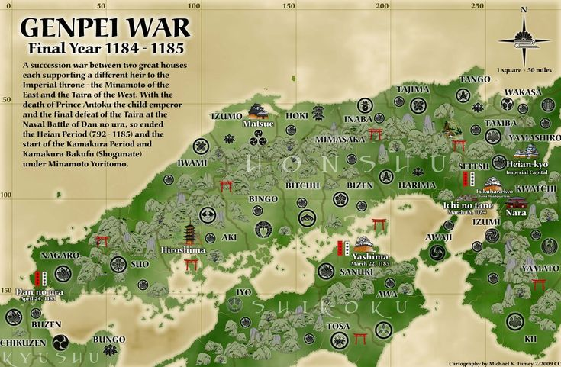


Genpei War
The Clash That Shaped the Samurai Era

Slide 2

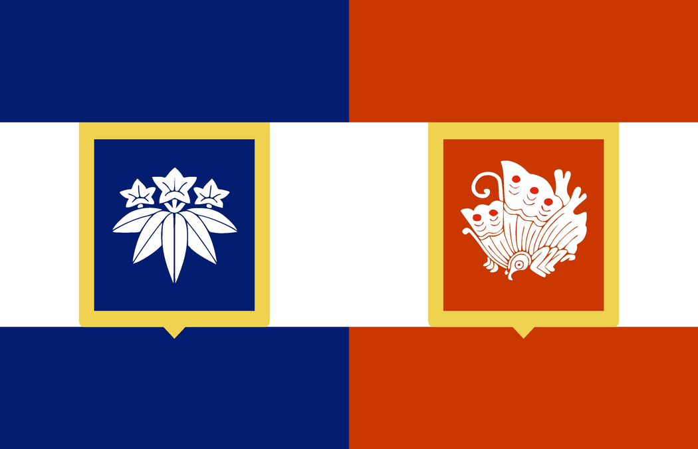
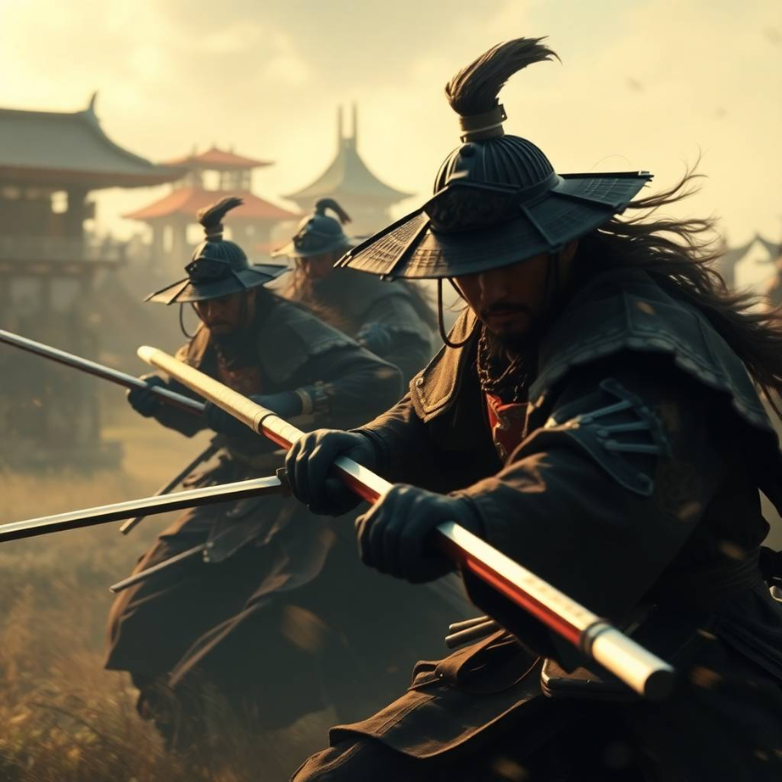
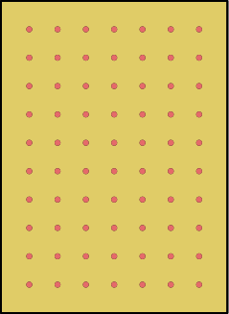

Introduction
The war began as a struggle for control over the imperial throne. In 1180, Emperor Go-Shirakawa’s son, Prince Mochihito, supported by the Minamoto clan, called for a rebellion against the ruling Taira clan, led by Taira no Kiyomori. Kiyomori had seized power and placed his infant grandson, Emperor Antoku, on the throne, effectively controlling Japan. This sparked resentment among rival samurai clans and court factions, leading to an all-out war between the Taira and Minamoto.

Slide 3
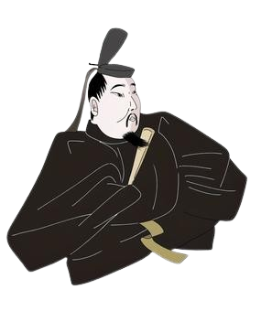
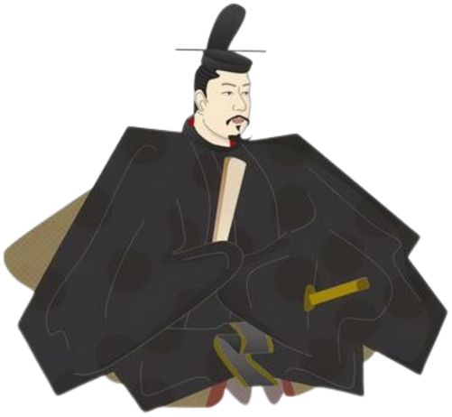
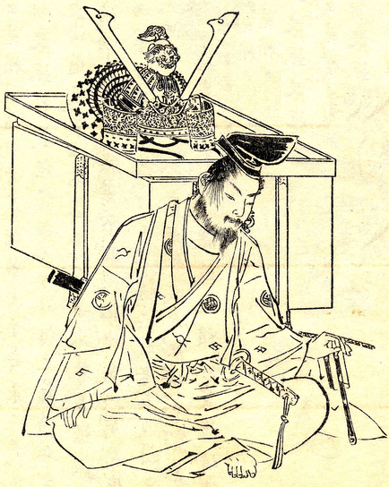
Main Figures of the War
MINAMOTO NO YORITOMO
MINAMOTO NO YOSHITSUNE
TAIRA NO MUNEMORI
(1147–1199)
(1159–1189)
(1147–1185)

Slide 4
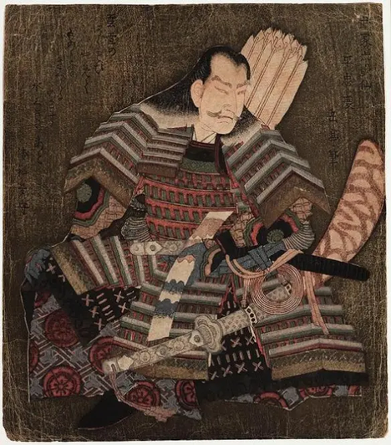
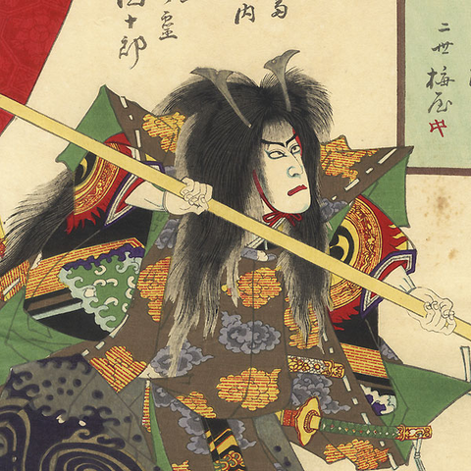
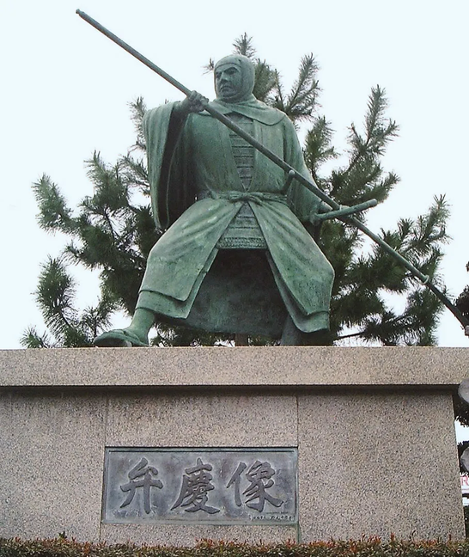
Main Figures of the War
TAIRA NO KIYOMORI
TAIRA NO TOMOMORI
BENKEI
(1118–1181)
(1152–1185)
(?-1189)

Slide 5
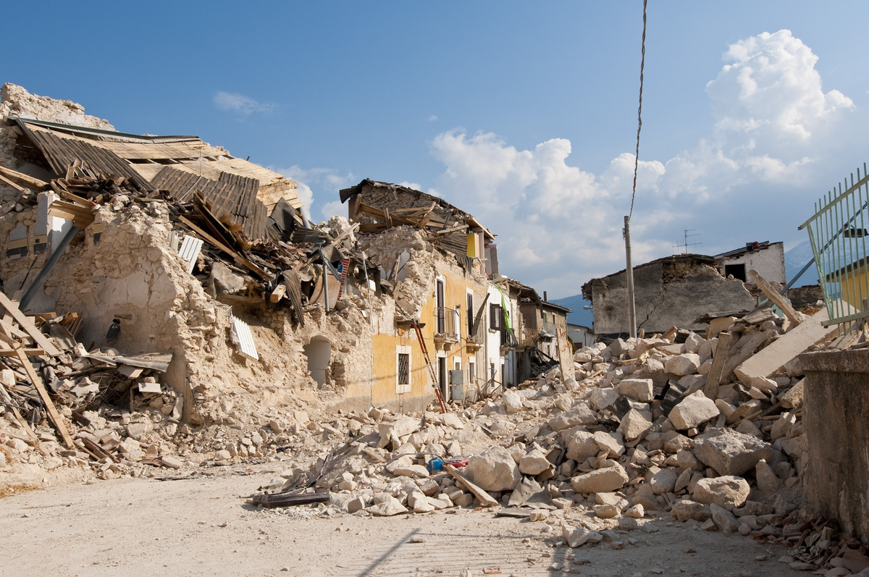


1156
1160
(June 1180)
Heiji
Rebellion
Hōgen
Rebelion
Battle of Uji (1180)
First major battle of the Genpei War.
First recorded instance of samurai seppuku as a way to preserve honor.
Famous for warrior monks defending a bridge, a rare sight in war history.
Set the tone for the Minamoto-Taira conflict—ruthless, tactical, and filled with legendary heroism

Slide 6
(Yoshinaka was killed)
Battle of Awazu
Battle of Ichi-no-Tani
(
Yoshitsune’s brilliant cliff charge made Taira retreat to Yashima
)
(June 1180)
1184
1184
Battle of Kurikara (1183)
First recorded use of psychological warfare in samurai battles – Yoshinaka’s oxen trick was both terrifying and devastating.
One of the deadliest samurai ambushes in history – The 3 phase ambush – An estimated 25,000 Taira soldiers were wiped out in a single night.
The beginning of Minamoto dominance – After this, the Taira never fully recovered from their loss.
Kurikara became a legendary tactic – Future samurai warlords studied Yoshinaka’s brilliant ambush strategy for centuries.

Slide 7
Yoshitsune make Taira leave their strong hold
Battle of Yashima
(April 1185)
(April 1185)
Battle of Dan-no-ura (1185)
The Taira had nowhere left to run and made their last stand at Dan-no-ura, a strait in the Inland Sea.
At first, the Taira were winning because their sailors were more experienced at sea. But then, a Taira general named Taguchi Shigeyoshi betrayed them and revealed their battle plans to Yoshitsune!
Taira no Tomomori and many Taira warriors committed suicide by jumping into the sea.
Emperor Antoku’s grandmother took him in her arms and leaped into the ocean, drowning the young emperor to prevent his capture.

Slide 8
Building Earthquake-Resistant Structures
When earthquakes strike, they can result in the collapse of buildings, bridges and other infrastructure, leading to injuries and fatalities.
What are some ways to strengthen buildings and structures to reduce the impact of earthquakes, especially in the Asia-Pacific region?

